Slide 1

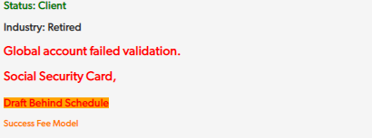
Global Validation Request
Reviewed 7/26/2023
Whenever you complete a Global Validation dialer call or see alerts that state: Global account failed validation or Multiple Global Accts Open – WILL NOT DRAFT
Review the request to see what is needed
To Address Alert
Advise client of what is needed
Social Security Information
Provide client with your email or the fax number (443.279.2875) to submit documentation
If client must contact Global Holdings, provide their number (1.877.271.1550)
Notate request with what documentation the client is sending or when they will contact Global
Proof of residence/address
Once documentation is received or client has contacted Global
Notate clients Global Validation Request appropriately
Click on Add Request from the Request Section
Request Type = Global Validation
Next Global Occurrence = Today’s date
Responder = Yourself
Internal Status
If documentation has already been received, Upload to Global Holding Website
If waiting for documentation, Waiting on Responder
Request Field = brief description of reason for request and what has been done
Attach documentation, if applicable, to the Client File
Upload signed SPAA to the Crush FTP folder as a PDF file
Upload documentation to Client File
ID – Must be current
Once confirmed it has been accepted, mark request as completed
If Request Needs to be Created
Keep request as pending, in 24rs confirm GH has accepted the document
Save SPAA with the following naming convention (formatting will matter – match the spaces below)
Global Account Number–SPAA
Global Account Number–ID
Global Validation request should never be withdrawn from agents Responder Queue until flipped to Internal Status as Waiting for Accounting.

Slide 2
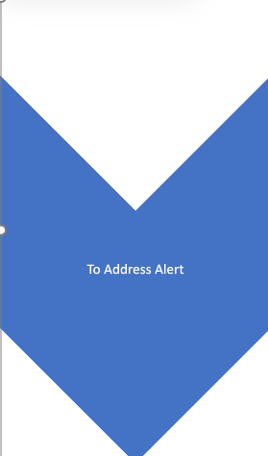
Global Validation Request - Extended
Additional Global verifications for proof of address challenges:
Military Personnel – A letter from a commanding officer on official letterhead advising of the client’s address
Tribal Members - A letter from postal service with directions to get to their house
Living with a friend or family - A letter from the homeowner advising the client lives at their address with a copy of their current utility bill
Temporary Housing (shelter/hotel) - A letter from a shelter manager on official letter head verifying client temporarily resides at that address.
Global Validation request should never be withdrawn from agents Responder Queue until flipped to Internal Status as Waiting for Accounting.

Slide 3
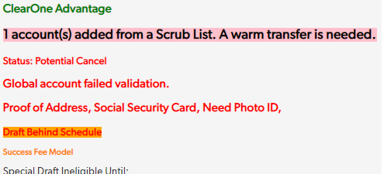
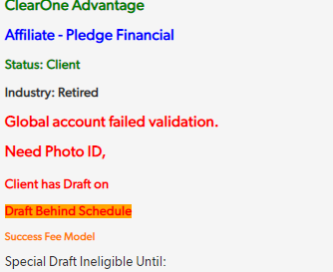
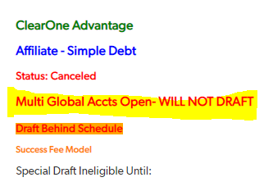


Verifying Client’s Needs
When a client’s Global account has Failed Validation, an alert can be found in the client’s alert section on their main page via QuickBase or in the Global Information section. This is a crucial step to take when finding the root cause of the Failed Global Validation.
There are many different reasons a client’s account is unable to be verified via Global. We will briefly summarize those reasons and ways to find them.
*All Verification Documents need to be saved as PDF. ID included.*
(JPEG images no longer accepted)
Checking Points

Slide 4
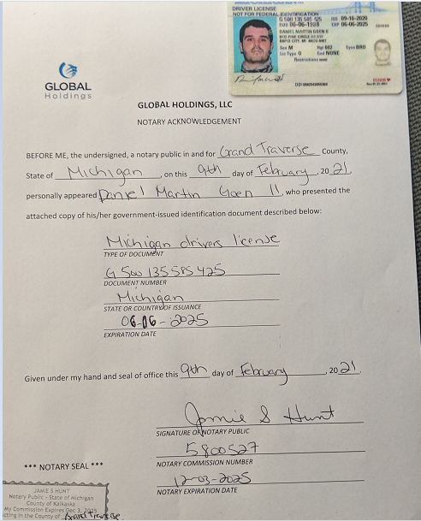
Documents Needed – Global Notary AK Form/ID
This form is requested normally when a client’s identity cannot be verified. Please reference the bullet points below and picture:
This form would need to be filled out by the client’s bank.
The client’s photo ID would need to be seen on the documentation.
The client’s form should look like the picture when being turned in and photo ID must be visible as shown in the photo.
The document must be saved as “globalnotaryform” all lowercase letters and no spaces.

Slide 5
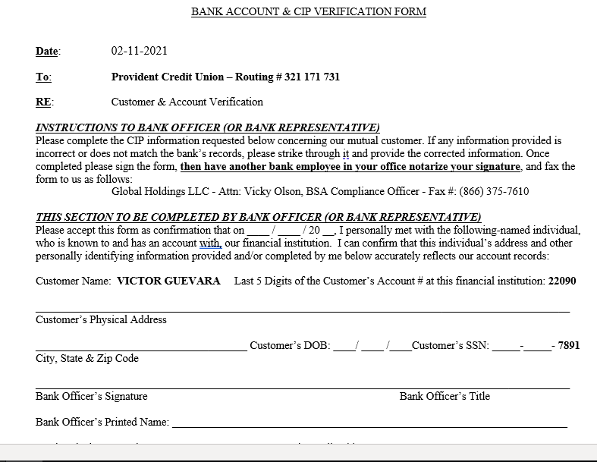
Documents Needed – Bank Verification Form
This form is requested normally when a client’s identity cannot be verified. Please reference the bullet points below and picture:
This form is a form that would need to be filled out by the client’s bank and returned.
Directions will be sent along with the document for bank representatives to follow accordingly.
This form will be sent to us directly from Global if the client needs to take the document into their bank to have it filled out.

Slide 6
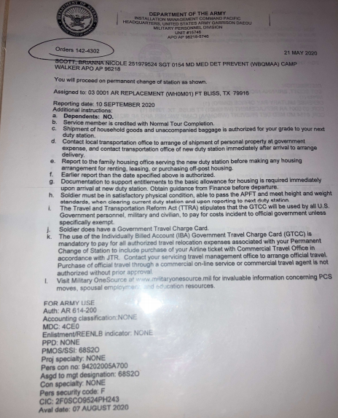
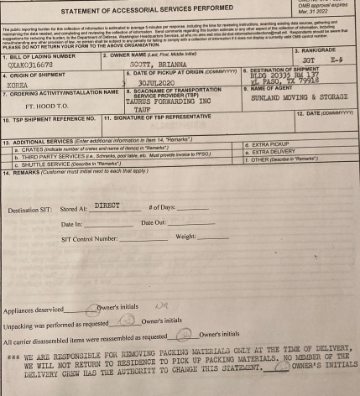
Documents Needed – Miscellaneous
This request isn’t required as often. However, when Global Holdings is requesting forms of POR/UTB via leasing form or special cases where a client may not be able to provide the standard documents needed. Please reference the bullet points below and pictures:
The forms shown in the picture are usually needed from client’s who are either serving in the military or have retired.
Finding documentation to help validate their account may be a challenge but when you communicate with the client on what is needed, it can be done.

Slide 7
Global Validation Request – Validation Documents
Here’s a list of documents Global Holdings will accept for validations
UTB (Proof of Residence) requested: (documents must be dated within the past 6 months, and match the address listed on the client DAAA) | SSN document requested: | ID Requested: (non-U.S. Government issued IDs are not accepted/Temp ID's not Accepted)
When uploaded must be named: Client Proof of Address Verification | When uploaded must be named: Client SSN Verification | When uploaded must be named: Client ID Verification
Utility Bill (•Full Service address must be stated. Electronic bills are accepted.) | Social Security Card (must be signed) | US Driver’s License
Delivery Receipt (Shipping labels are not accepted) | Social Security Statement (must be signed) | State ID Card
Property Tax Statement | A letter from the Social Security Administration | Permanent Resident ID Card
Homeowner’s Insurance | ITIN Card (must be dated within 3 years) | Passport
Home Loan Statement | Tax Return dated < 3 years acceptable if ITIN Statement is > 3 years | Resident Alien Card
Something mailed(USPS) to the client’s physical address |  | US Birth Certificate
Valid ID listing physical address |  | US Visa
Lease/Rental agreement (all pages)
Vehicle Registration

Slide 8
Multi Global Accounts Open – WILL NOT DRAFT
Inquire if the client is working with a second debt settlement company
If yes, client needs to let Global Holdings know that they want to keep both accounts open
If no client needs to let Global Holdings know to close secondary account
No GV request required
Submit GV Request
  If speaking to client by phone, WT to GH
  If speaking to client via chat or email – provide GH contact info
Customersupport@ghllc.com
1-877-271-1550

Slide 9
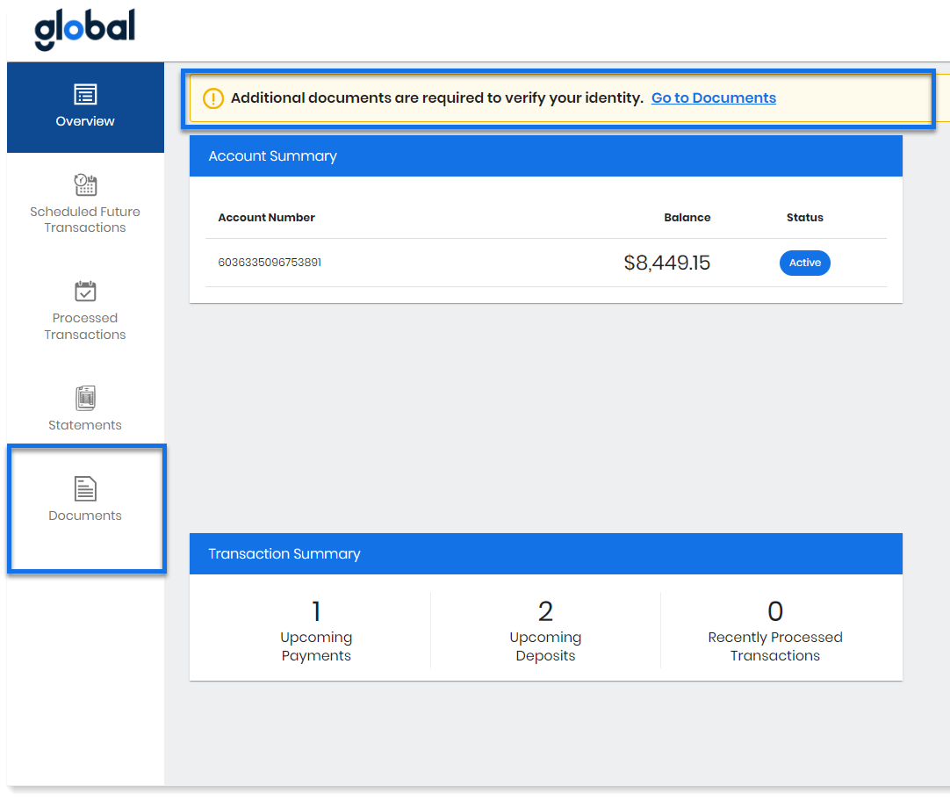
Secure Document Upload on the Client Website
Clients can securely upload their necessary documents, view the document status.
Client Website Example: This example shows the new banner, indicating to clients that their attention is required, and the new Documents tab.

Slide 10
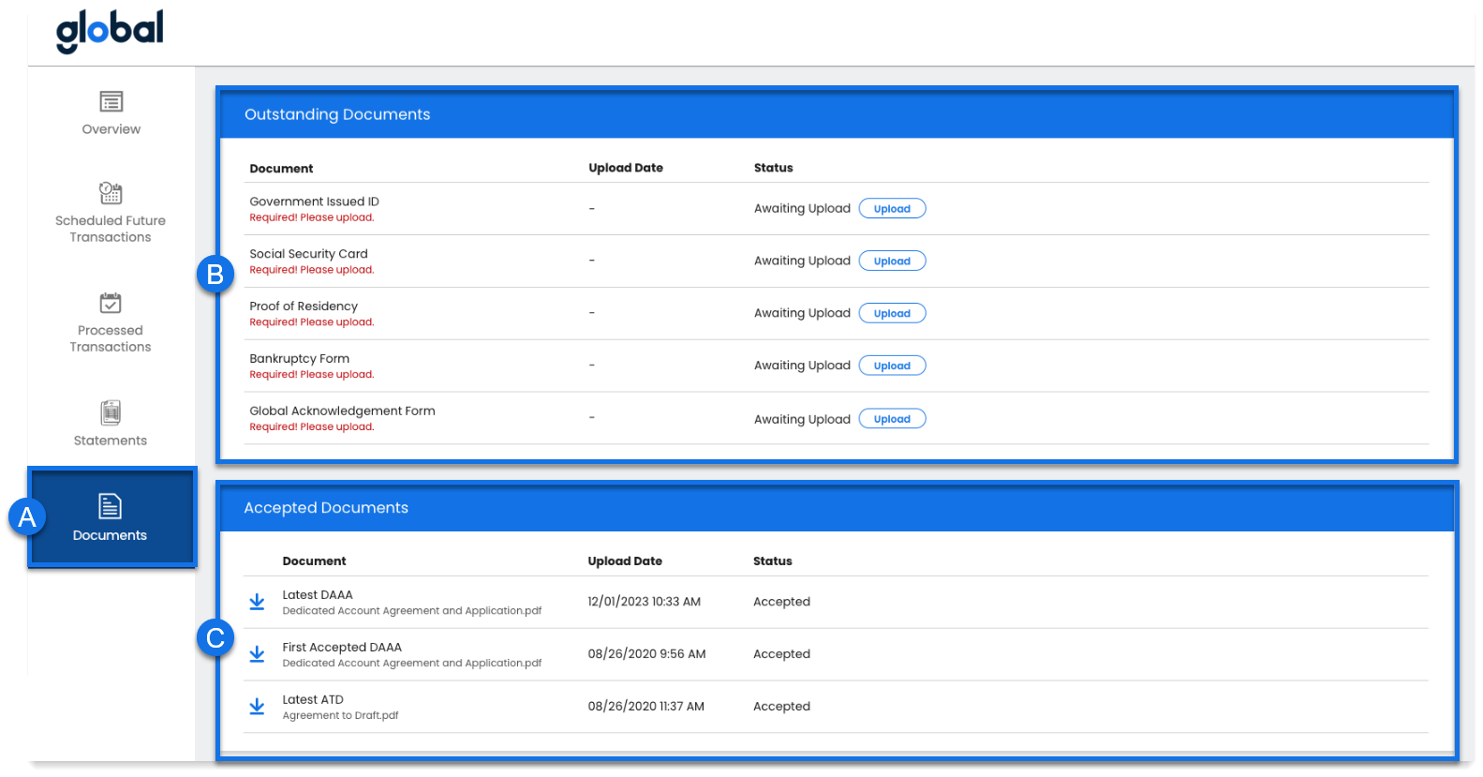
Secure Document Upload on the Client Website
Documents Page Example: This is the client’s view of the documents page. A client can view a list of all uploaded documents, see the status, and review rejection reasons.
a. New “Documents” Tab b. Outstanding Documents & Status | c. Accepted Documents d. Document Status & Rejection Reasons

